Slide 1
PORTABLE ATTENDANCE MONITORING USING FACE RECOGNITION
Batch-11
Project Guide :- Mr. Atchut Vardhan k
M.Tech
Project Team :-
Srikanth V.M.K (15331A1253)
Hari Prasad k (15331A1223)
Priyanka k (15331A1221)

Slide 2
Contents
Abstract
Internet of Things
Machine Learning
Attendance Monitoring System
Face Recognition
Proposed System
Face Detection
Face Recognition Algorithms
Implementation
Future Scope
Status
Q & A

Slide 3
Abstract:
Automation has become the order of an hour. 80% of the things have been automated in every sector. So, the demand for automation is increasing at a tremendous rate. Nowadays, face recognition and detection has evolved rapidly. Using a Face Recognition system is a way better than other biometric systems because it involves a moderate computation. The project is about monitoring attendance using face recognition. Which is done using OpenCV(Open Computer Vision) programmed with python. Detection and recognition of face lead to the generation of attendance reports and the reports are published.

Slide 4
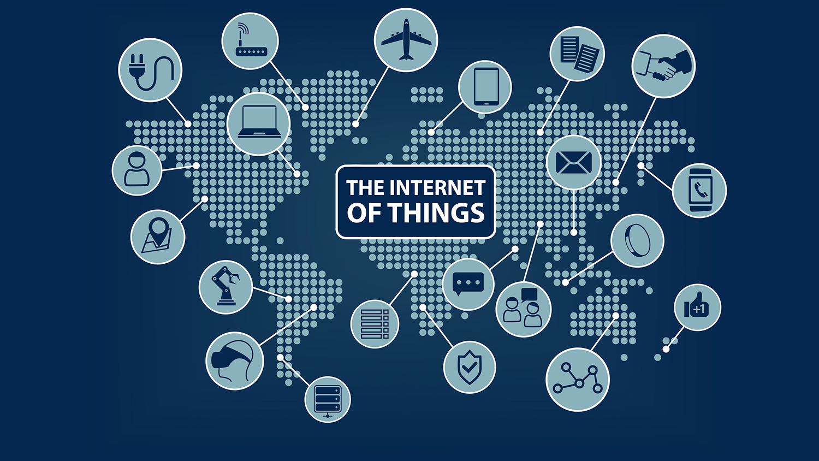
Internet of Things
The Internet of things is the network of devices, vehicles, and home appliances that contain electronics, software, actuators, and connectivity which allows these things to connect, interact and exchange data.

Slide 5
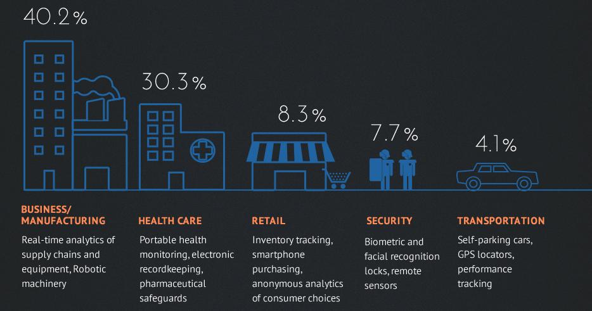

Slide 6
Machine Learning
Machine learning is the study of algorithms and statistical models that computer systems use to progressively improve their performance on a specific task.

Slide 7
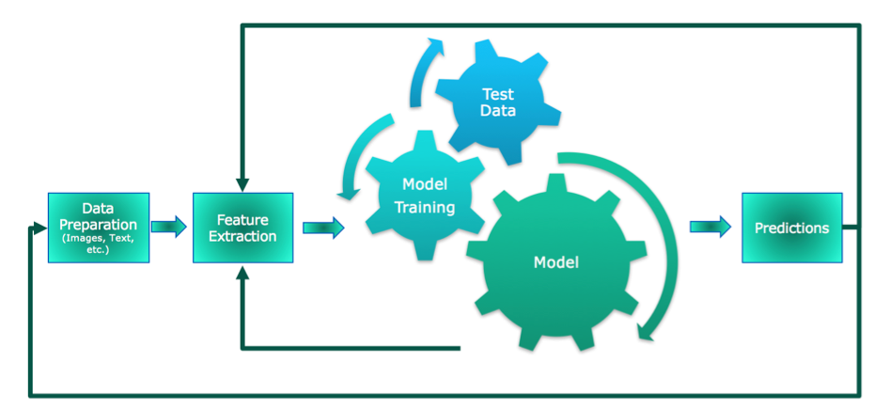
Standard Machine Learning Pipelining

Slide 8
Attendance Monitoring System
Manual Attendance (Register)
Biometric
Fingerprint Scan
Face Recognition
Iris Scan
Voice Scan
Signature Scan

Slide 9
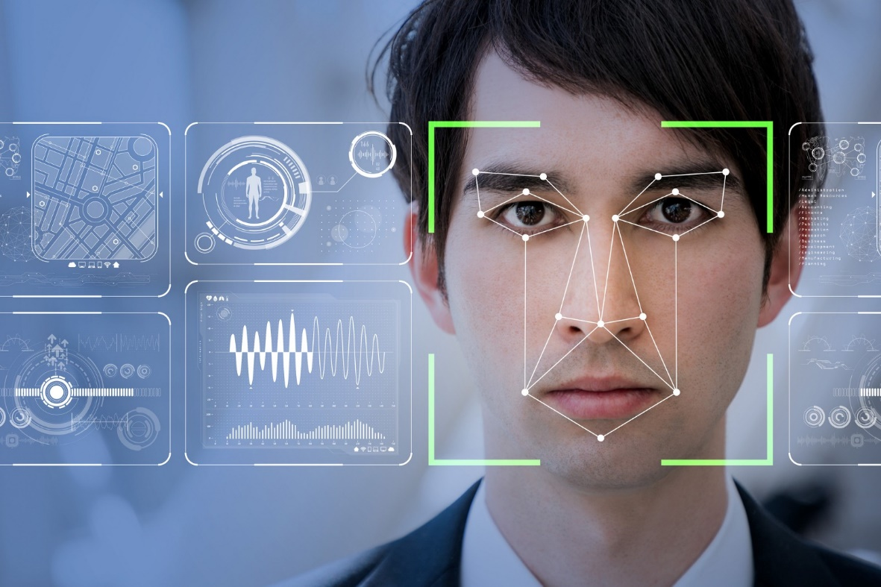
Face Recognition
A facial recognition system is a technology capable of identifying or verifying a person from a digital image or a video frame from a video source.

Slide 10
Face Recognition
Face Detection
Face Identification

Slide 11
Proposed System
Attendance Monitoring System using Face Recognition (IOT + Machine Learning)
(to be continued)

Slide 12
Start
Image Acquisition using Camera
Face Detection
Background noise elimination and deduplication of image
Face Recognition
Generate Report
Publish Report
Stop

Slide 13
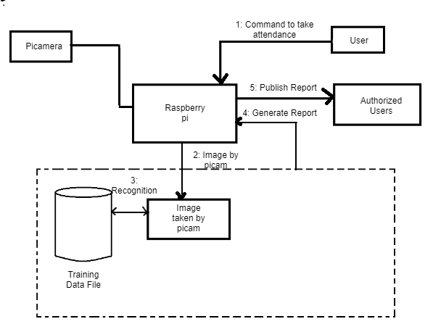

Slide 14


Face Detection
Haar features
Ada Boost

Slide 15
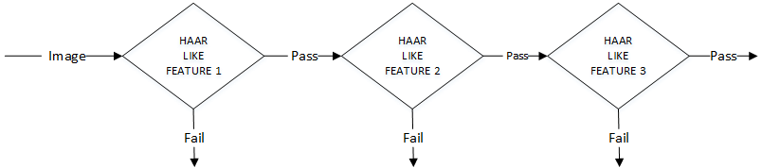
HAAR Cascades Classification

Slide 16
Face Recognition Algorithms
1. Eigen Faces
2. Fisher Faces
3. Local Binary Pattern Histogram (LBPH)

Slide 17
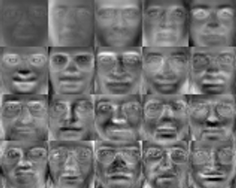
Eigen Faces

Slide 18
Principal Component Analysis(PCA)
PCA Algorithm
Input: -
K: A set of data of Eigen Faces.
Process: -
Step 1: Arbitrarily choses k Eigen faces from the training data.
Step 2: Repeat
Step 3: The PCA computes the variance of the Eigen Faces.
Step 4: If the maximum variance is obtained, store those features and if due to any one Eigen Face the variance is minimum, then those set of features are discarded.
Step 5: PCA again computes by considering the discarded features with the features with maximum variance.
Step 6: Until, the process reaches saturation point when the discarded features computed with features with high variance, the variance will be minimum.
Output: -
A set of k-Eigen faces with high variance.

Slide 19
Flow for Eigen Face Recognition
Start
Training Data
E= (Generate Eigen
Faces for training data)
W _{i} = (weights of Eigen
Faces for training data)
New image ‘a’
Face ‘a’ is not recognized
Stop
W _{j} = (weights of Eigen
Faces for test data)
no
D >
Threshold
value
yes
Face ‘a’ is recognized
D = (Average distance between (w _{i}-w _{j}))

Slide 20
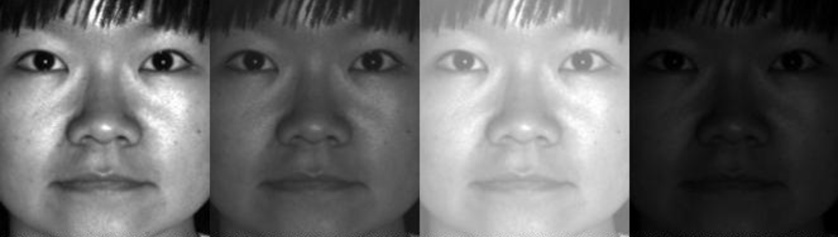
Drawbacks of Eigen Face
Doesn't work properly under bad lighting conditions.
PCA takes large time to compute.
Fisher Face

Slide 21
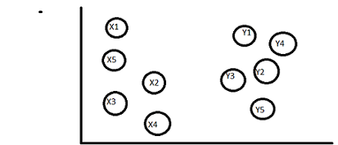
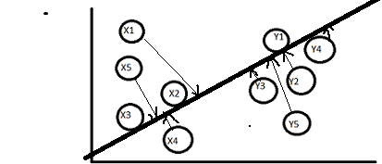
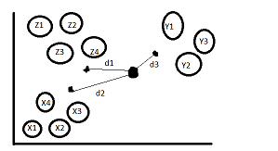
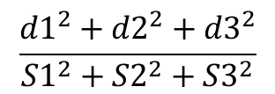
Linear Discriminant Analysis (LDA)
For 2-D Plane
$$\frac{{d1}^{2}+{d2}^{2}+{d3}^{2}}{{S1}^{2}+{S2}^{2}+{S3}^{2}}$$
For 3-D Plane

Slide 22
Local Binary Pattern Histogram (LBPH)
LBPH Algorithm
Input: -
K: Pic taken by Pi Camera.
Process: -
Step 1: First the center pixel value is taken.
Step 2: Now, the each pixel value is subtracted from the central pixel value.
Step 3: If the value is less than the central pixel value then it is marked as 1.
Step 4: Else if the value is greater than or equal to the central value then it is marked as 0.
Step 5: Now everything is marked as 0’s and 1’s.
Step 6: In clockwise direction the values are written a binary value will be obtained.
Step 7: The decimal equivalent values of that binary format is obtained. Now store this in database.
Output: -
Histogram value of the photo which is decimal value of binary value.

Slide 23
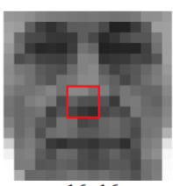
Example
11100001
225

Slide 24
Face Detection Implementation:
Packages used:
picamera // This package will have functions for operations using picamera
cv2 // This will have all the openCV methods
Functions used:
picamera( ) // This will create an object for the picamera to take a picture
start_preview( ) // This will open the camera to take a picture
capture( ) // This will capture the photo
stop_preview( ) // This will stop the camera from viewing
cv2.imread( ) // This will read an image from file
cv2.CascadeClassifier( ) //This will load the haar cascade classifier
cv2.cvtColor( ) // This will convert the color image into grayscale
cv2.rectangle( ) // This will draw a rectangle box around obtained faces
cv2.imwrite( ) // This will store the obtained image

Slide 25
Program for Face Detection:
import picamera
import cv2
import time
camera = picamera.PiCamera()
camera.start_preview()
time.sleep(5)
camera.capture('snapshot.jpg')
camera.stop_preview()
image = cv2.imread("/home/pi/snapshot.jpg", 3)
face_cascade = cv2.CascadeClassifier('haarcascade_frontalface_default.xml')
gray = cv2.cvtColor(image,cv2.COLOR_BGR2GRAY)
faces = face_cascade.detectMultiScale(gray, 1.1, 5)
print "Found "+str(len(faces))+" face(s)“
for (x,y,w,h) in faces:
cv2.rectangle(image,(x,y),(x+w,y+h),(255,0,0),2)
cv2.imwrite('result1.jpg',image)

Slide 26
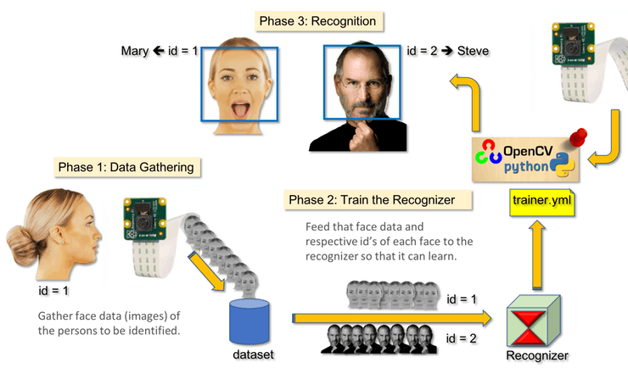

Slide 27
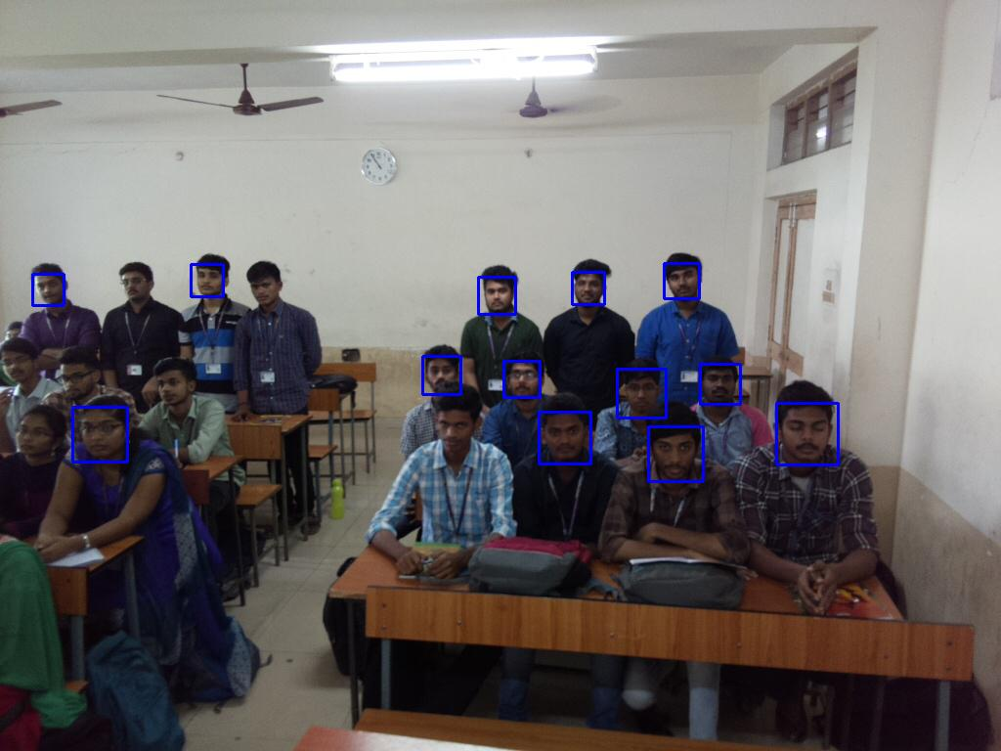
Output for Face Detection:

Slide 28
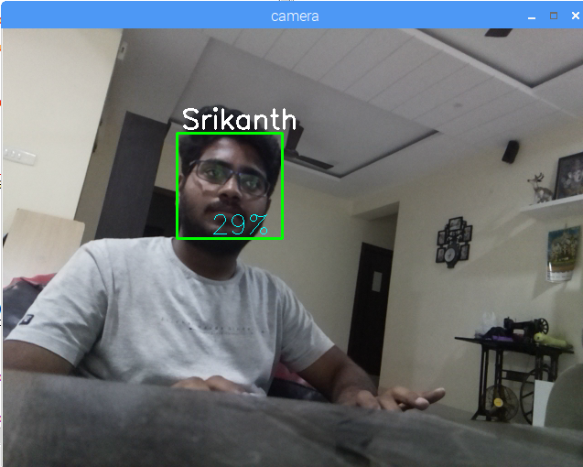
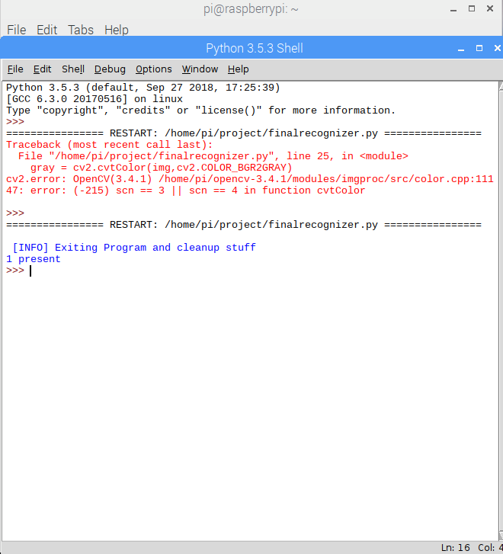
Output for Face Recognition

Slide 29
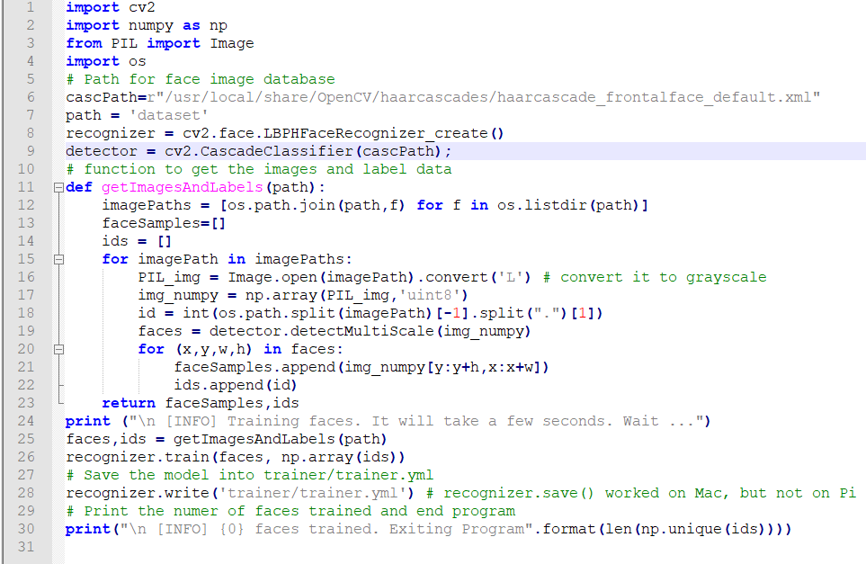
Traindata.py

Slide 30
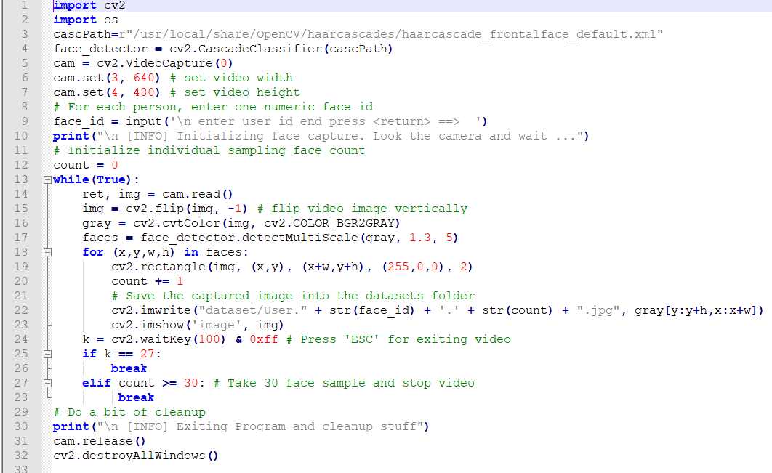
Recognizer.py

Slide 31
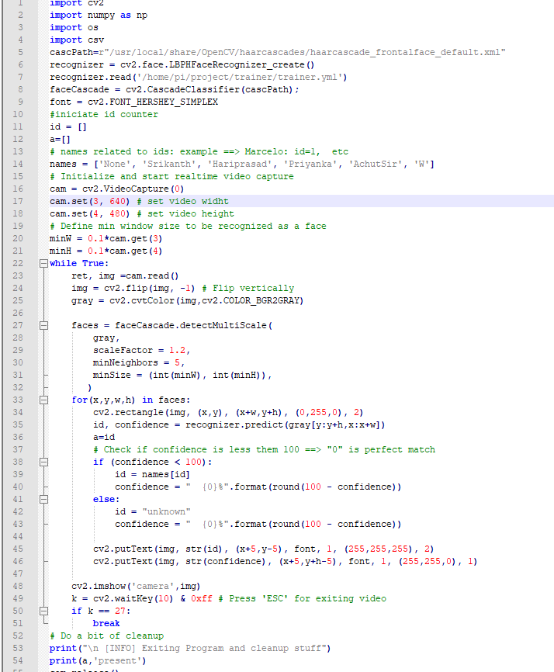
finalrecognizer.py

Slide 32
Future Scope
Dynamic Camera Orientation
Cloud Integration (AWS)

Slide 33
Send Picture
Stores and Sends report
AWS Cloud
Local System

Slide 34
Status
Requirements Specification : 100%
Design and Analysis : 90%
Implementation : 40%
Testing and Deployment : 10%
Final submission : February last week

Slide 35
Q & A

Slide 36
Thank You

